Slide 1

Fetal growth restriction:
Screening and diagnosis; Evaluation and management
Journal Club Presented by Shahla Faal, PhD Student of Midwifery
Farideh eghdampour Master of Midwifery

Slide 2
NORMAL FETAL GROWTH
Population-based intergenerational studies of birth weight have concluded that genetic factors account for 30 to 50 percent of the variation in birth weight, with the remainder due to environmental factors.
Maternal genes influence birth weight more than paternal genes, but both have an effect.
In terms of individual biometric measurements, the rate of change in biparietal diameter, head circumference, femur length, and abdominal circumference initially peaks at 13, 14, 15, and 16 weeks, respectively, and then has a second acceleration at 19 to 22, and 27 to 31 weeks, respectively.
Estimated fetal weight growth velocity peaks at around 35 weeks.
In general, normal growth in singletons increases from approximately 5 g/day at 14 to 15 weeks of gestation to 10 g/day at 20 weeks and 30 to 35 g/day at 32 to 34 weeks.

Slide 3

IUGR
is the term used to describe a fetus that has not reached its growth potential . The origin of the problem may be fetal, placental or maternal,with significant overlap among these entities.

Slide 4
DEFINITION OF FGR
Definition: an estimated weight below the 10th percentile for gestational age in the second half of pregnancy, although other definitions employing a variety of criteria have been advocated (eg, <5th percentile, <3rd percentile)
As many as 70 percent of fetuses who are estimated to weigh below the 10th percentile for gestational age are small simply due to constitutional factors such as maternal ethnicity, parity, or body mass index; they are not at high risk of perinatal mortality and morbidity

Slide 5
CLASSIFICATION
FGR may be classified as symmetric or asymmetric:
Symmetric FGR comprises 20 to 30 percent of FGR and refers to a growth pattern in which all fetal organs are decreased proportionally due to global impairment of cellular hyperplasia early in gestation.
Symmetric FGR is thought to result from a pathologic process manifesting early in gestation

Slide 6
CLASSIFICATION
Asymmetric FGR comprises the remaining 70 to 80 percent of the FGR population and is characterized by a relatively greater decrease in abdominal size (eg, liver volume and subcutaneous fat tissue) than in head circumference. Asymmetric fetal growth is thought to result from the capacity of the fetus to adapt to a pathologic environment late in gestation by redistributing blood flow in favor of vital organs (eg, brain, heart, placenta) at the expense of nonvital fetal organs (eg, abdominal viscera, lungs, skin, kidneys)

Slide 7
Determine the cause
A complete history and physical examination is performed to assess for maternal disorders that have been associated with restricted fetal growth.
Severe preeclampsia and chronic hypertension
Vascular disease caused by diabetes
Heart, Renal, vascular disease
Chronic hypoxia i.e. smoking, Asthma and Living at high altitudes
some medications such as anticonvulsants, anti-neoplasms and immunosuppressant are commonly considered causal factors.
Antiphospholipid antibody syndrome (APS)
An association between the inherited thrombophilias and FGR is weak.

Slide 8
Aneuploidy and SGA
Down’s Syndrom ------ mild SGA
Terner Syndrom------- moderate SGA ------ 6.6 times of SGA
trisomy 18 ------- Severe SGA
trisomy 13-------- Severe SGA
Klein-Filter syndrome does not limit fetal growth.
In the first trimester screening, a decrease in PAPP-A and HCG, AND in a second trimester screening, an increase in AFP, inhibin-A, and a decrease in Esterol increase the likelihood of growth restriction.

Slide 9
Anomalies associated with FGR include
omphalocele,
gastroschisis,
diaphragmatic hernia,
skeletal dysplasia,
and some congenital heart defects.
Fetal survey
– A detailed fetal anatomic survey should be performed in all cases since approximately 10 percent of FGR is accompanied by congenital anomalies and 20 to 60 percent of malformed infants are SGA.
A fetal echocardiogram is indicated if results of an expert (level II) ultrasound examination suggest any uncertainty that the heart is normal.

Slide 10
Fetal genetic studies
Fetal genetic studies are indicated in any of the following settings because of the increased risk of an abnormality:
FGR that is all of the following: Early (<24 weeks), severe (<5th percentile), and symmetrical.
FGR with major fetal structural abnormalities.
FGR with soft ultrasound markers associated with an increased risk of aneuploidy, such as thickened nuchal fold/choroid plexus cyst and abnormal hand positioning
Placental findings suggestive of a partial molar pregnancy: Enlarged, cystic spaces and/or increased echogenicity of chorionic villi.

Slide 11
Work-up for infection
When infection is suspected clinically because of maternal history, physical examination, or fetal ultrasound findings, maternal serum should be examined for seropositivity (and evidence of acute infection if positive).
Infections associated with FGR include cytomegalovirus, toxoplasmosis, rubella, and varicella.
Sonographic markers for fetal infection are often nonspecific but include echogenicity and calcification of the brain and/or liver and hydrops.
Malaria in pregnancy can also cause FGR and should be considered in endemic areas.
Maternal COVID-19 does not appear to be associated with an increased prevalence of FGR.

Slide 12
SCREENING:Rationale
Ideally, prenatal detection of FGR will provide an opportunity to employ interventions to reduce the morbidity and mortality associated with this problem.
Adverse outcomes include prematurity, perinatal asphyxia, hypoglycemia, polycythemia resulting in hyperviscosity, impaired immune function, stillbirth, neonatal death, and neurodevelopmental delay.

Slide 13
Screening tests
Symphysis-fundal height measurement —
Measurement of the distance between the upper edge of the pubic symphysis and the top of the uterine fundus using a tape measure is a simple, inexpensive, and widespread technique performed during antenatal care to detect FGR, as well as other disorders that result in size/date discrepancy.
The most common criterion is a fundal height in centimeters that is at least 3 centimeters less than the gestational age in weeks (eg, fundal height 32 cm at 36 weeks of gestation)
Factors that may affect sensitivity include maternal body mass index, bladder volume, parity, and ethnic group. This technique appears to perform best when all of the measurements are obtained by the same clinician using the unmarked side of the tape to reduce bias .
The performance of fundal height measurements for screening for FGR is controversial.

Slide 14
Universal ultrasonography
Routine universal performance of ultrasound examination is an alternative method of screening for FGR.
In general, if two screening examinations are performed after the second trimester fetal anatomic survey, they are obtained at approximately 32 and 36 weeks of gestation.
Third trimester measurements are then compared with those predicted by the second trimester measurements for the specific fetus, not with a population standard, thus using the fetus as its own control.

Slide 15
In women at high risk for FGR, detailed sonographic assessment of the fetus, placenta, and amniotic fluid is performed once or twice in the third trimester and when a lag in fundal height is detected in order to support or exclude the diagnosis.
In the general/low-risk obstetric population, the ultrasound examination is only performed when a lag in fundal height is detected, the fundal height cannot be palpated, or the fundal height is not reliable (eg, large fibroids)

Slide 16

DIAGNOSIS
sonographic estimation of fetal weight <3rd, 5th, or 10th percentile is the single best finding on which to base the diagnosis of FGR .
Findings on Doppler velocimetry of the umbilical artery are insensitive diagnostically but predictive of outcome.
Overall, it is reasonable to assume that a fetus <10th percentile with a normal growth curve over three weeks, normal amniotic fluid volume, and normal Doppler velocimetry is at low risk of adverse outcomes of FGR, especially in the absence of risk factors for FGR, whereas the fetus <10th percentile with a lagging growth curve, oligohydramnios, and maternal risk factors for the adverse outcomes of FGR is probably affected and at high risk of complications if Doppler velocimetry is abnormal.

Slide 17
DIAGNOSIS
ACOG Practice Bulletin on FGR considers an estimated fetal weight (EFW) <10th percentile suggestive of FGR and a finding that warrants further evaluation, such as amniotic fluid assessment and Doppler blood flow studies of the umbilical artery.
the Royal College of Obstetricians and Gynaecologists (RCOG) considers either EFW <10th percentile or abdominal circumference (AC) <10th percentile reasonable criteria for FGR. Using RCOG criteria, a fetus with a small AC but an EFW >10th percentile would be considered growth restricted.

Slide 18
DIAGNOSIS
Estimated fetal weight — Fetal weight estimation is the most common method of identifying the growth-restricted fetus
NICHD in fetal growth studies have published comprehensive tables of the 5th, 10th, 50th, 90th, and 95th percentiles for estimated fetal weight (EFW) and individual biometric parameters by race and ethnicity
Serial sonograms are obtained at two- to four-week intervals to ascertain the growth velocity; the longer end of this range is appropriate for the fetus with mild FGR (eg, EFW near the 10th percentile, normal amniotic fluid volume, normal Doppler findings), with a shorter interval for the fetus with features of moderate or severe disease (eg, EFW ≤5th percentile, oligohydramnios, abnormal Doppler findings).

Slide 19


Slide 20
Biometry
Abdominal circumference — When fetal growth is compromised, the fetal abdominal circumference (AC) is smaller than expected because of depletion of abdominal adipose tissue and a reduction in hepatic size from depletion of glycogen. Most studies report that reduced AC is the most sensitive single biometric indicator of FGR.
biochemical markers of hypoxia and acidemia are more common when the AC is below the 5th percentile for gestational age
Measurement of AC was more predictive of FGR than measurement of either head circumference (HC) or biparietal diameter (BPD) or the combination of AC with either one of these two variables.
The optimal time to screen for FGR with AC was at approximately 34 weeks of gestation.

Slide 21
Biometric ratios
The HC/AC and femur length (FL)/AC have been used to identify the growth-restricted fetus and are most sensitive in the setting of asymmetric FGR.
HC/AC ratio — In asymmetric FGR, the size of the liver tends to be disproportionately small compared with the HC and length of the femur, which are initially spared from the effects of nutritional deficiency.
The sensitivity, specificity, positive, and negative predictive values of an abnormal HC/AC in a population with FGR of mixed etiologies were 36, 90, 67, and 72 percent, respectively .
Macrocephaly or increased intracranial pressure could also be associated with an increased HC/AC ratio and should be excluded.

Slide 22
FL/AC ratio — The FL/AC ratio uses biometric parameters that relate to both weight and length in the prediction of FGR and is independent of gestational age in normally grown fetuses in the last half of pregnancy.
An FL/AC ratio >23.5 percent has been reported to have sensitivity of 56 to 64 percent and specificity of 74 to 90 percent for identification of asymmetric FGR but does not detect symmetric FGR.
The sensitivity, specificity, positive, and negative predictive values of the 90th percentile of FL/AC ratio in a mixed population of FGR fetuses were 30, 91, 14, and 96 percent, respectively.

Slide 23
Amniotic fluid volume — Oligohydramnios is one of the sequelae of FGR. The proposed mechanism is diminished fetal urine production due to hypoxia-induced redistribution of blood flow to vital organs at the expense of less vital organs, such as the kidney.
Oligohydramnios combined with EFW <3rd percentile is predictive of adverse outcome.
If oligohydramnios is present in the absence of ruptured membranes, congenital genitourinary anomalies, or prolonged pregnancy, FGR is the most likely etiology.
Using the oligohydramnios definition of largest vertical fluid pocket less than 1 cm, Manning reported sensitivity, specificity, positive, and negative predictive values for prediction of FGR of 84, 97, 90, and 95 percent, respectively

Slide 24
Doppler velocimetry — FGR may be associated with abnormal Doppler wave forms in maternal vessels (uterine arteries) and fetal vessels (umbilical arteries, middle cerebral arteries, ductus venous) when the etiology is placental dysfunction related to progressive obliteration of the villus vasculature.
●Umbilical artery – When 30 percent of the villous vasculature ceases to function, an increase in umbilical artery resistance leading to reduced end-diastolic flow is consistently seen and is a weak predictor of adverse outcome in FGR. When 60 to 70 percent of the villous vasculature is obliterated, umbilical artery diastolic flow is absent or reversed, and fetal prognosis is poor.
Reversed diastolic flow is associated with poorer neonatal outcomes than absent diastolic flow.

Slide 25

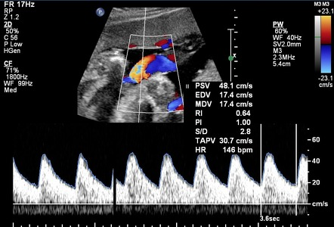

Slide 26
We perform weekly Doppler velocimetry of the umbilical artery upon diagnosis of FGR.
If consecutive Doppler results are normal, we decrease the frequency of Doppler examination to two-week intervals. The two-week interval is reasonable for the fetus with estimated fetal weigh ≥5th percentile, normal growth velocity, normal amniotic fluid volume, and no maternal risk factors for placental dysfunction.
The Society for Maternal-Fetal Medicine suggests umbilical artery Doppler studies every one to two weeks initially, and if normal, the interval between examinations can be lengthened .
If umbilical artery diastolic flow is present but pulsatility index >95th percentile, we perform weekly Doppler evaluation to look for progression to absent or reversed flow.
Absent or reversed end-diastolic flow in the umbilical artery can be a sign of impending fetal cardiovascular and metabolic deterioration.
If either of these abnormal patterns is identified, delivery should be considered

Slide 27
Ductus venosus — Doppler interrogation of the ductus venosus provides information about the hemodynamic status of the fetus.
Changes in the venous circulation in the growth-restricted fetus, including absent or reversed flow in the ductus venosus (absent or reversed a-wave) or pulsatile umbilical venous flow, are late findings, generally occurring approximately two weeks after changes are observed in the arterial circulation.
With progressively increasing umbilical arterial resistance, fetal cardiac performance can become impaired and central venous pressure increases, resulting in reduced diastolic flow in the ductus venosus and other large veins.
The ductus venosus resistance index increases, ultimately with loss of the a-wave. An absent or reversed ductus venous a-wave indicates cardiovascular instability and can be a sign of impending acidemia and death .

Slide 28
Each day of this Doppler abnormality doubles the odds of stillbirth, and fetal survival for more than one week is unlikely.
In early FGR (<30 weeks of gestation), the sensitivity of an absent or reversed ductus venous a-wave for fetal demise, neonatal death, and neonatal survival has been reported to be 88, 78, and 32 percent, respectively.
the absence of abnormal flow patterns in the ductus venosus has been used to support the decision to extend the pregnancy to 32 to 34 weeks, if the NST and BPP remain reassuring.

Slide 29
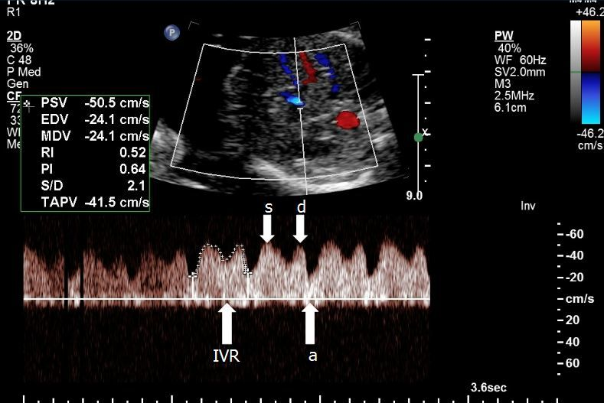

Slide 30
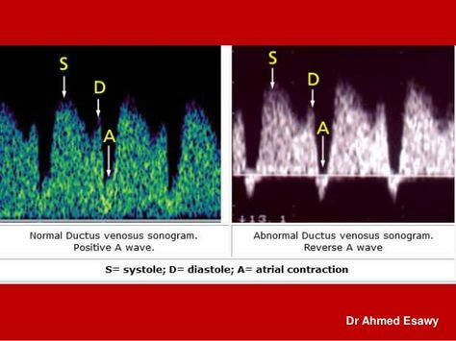

Slide 31
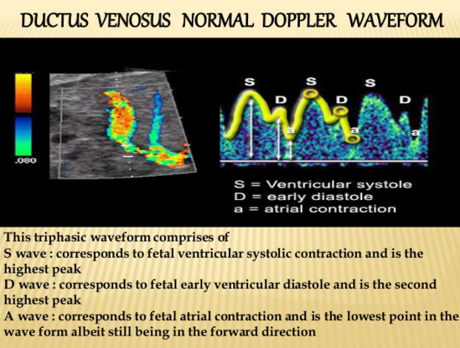

Slide 32
Middle cerebral artery — Doppler interrogation of the MCA also provides information about the hemodynamic status of the fetus.
The fetal brain in uncomplicated pregnancies has a high resistance circulation.
With progressive hypoxia, blood flow increases to compensate for the decrease in available oxygen (brain-sparing effect).
This results in a reduction in the Doppler parameters used to assess blood flow through the MCA:
the peak systolic to end-diastolic blood flow velocity ratio (S/D),
resistance index (RI),
and pulsatility index (PI) = (peak systolic flow - peak diastolic flow) / (mean flow).
There is no convincing evidence that interrogation of the MCA Doppler alone is useful in guiding clinical decisions about timing of delivery, although MCA Doppler alterations may be useful as an adjunct to umbilical artery Doppler interrogation for assessing the severity of hypoxia and predicting neonatal outcome.

Slide 33
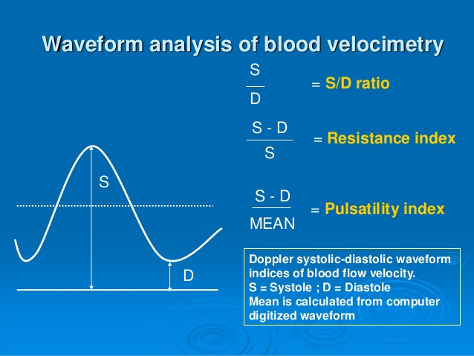

Slide 34
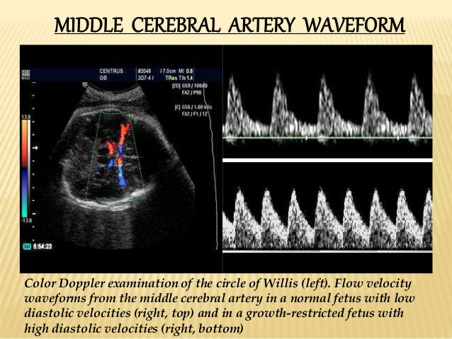

Slide 35
Cerebroplacental ratio — The cerebroplacental Doppler ratio (CPR) is the MCA pulsatility index (or resistance index) divided by the umbilical artery pulsatility index (or resistance index); a low CPR indicates fetal blood flow redistribution.
CPR was most useful for predicting adverse neonatal outcome when the umbilical artery Doppler pulsatility index was >95th centile.
An abnormal CPR has also been associated with abnormal fetal growth velocity, an increased risk for neonatal intensive care unit admission, and urgent cesarean delivery for fetal distress

Slide 36
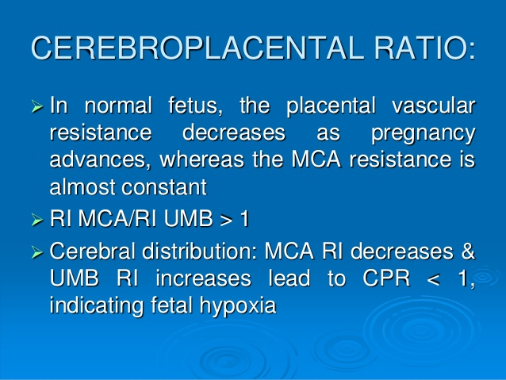

Slide 37
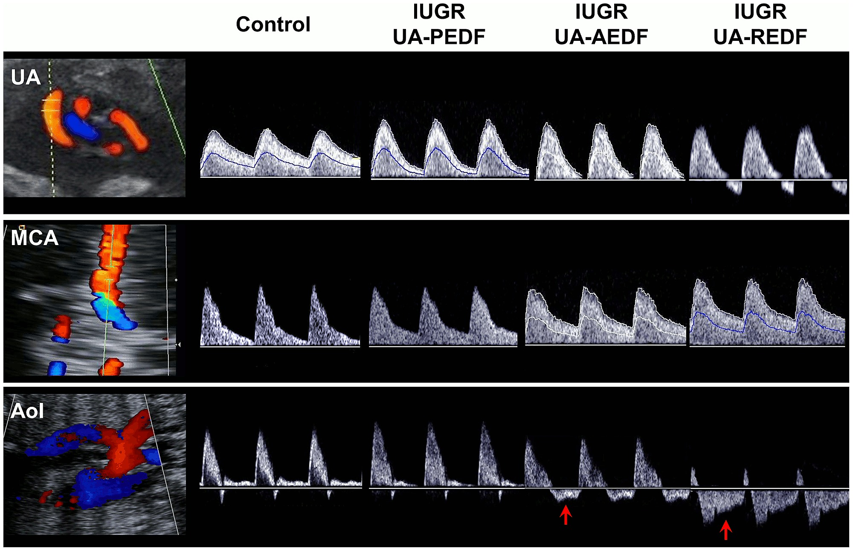
Doppler recordings from umbilical artery (UA) (top), middle cerebral artery (MCA) (middle) and aortic isthmus (AoI) (bottom) for the control and the three intrauterine growth restricted (IUGR) fetuses with present (PEDF), absent (AEDF) or reverse (REDF) umbilical artery end-diastolic flow. Red arrows indicated reversal flow in the AoI.

Slide 38
Nonstress test and biophysical profile — Either the NST with amniotic fluid volume determination or the BPP or a combination of both tests is reasonable for monitoring fetal well-being.
We use a combination of the NST and BPP to monitor FGR as these tests evaluate both acute and chronic fetal physiologic parameters.
The tests are relatively easy to perform, and fetal death within one week of a normal test score is rare .
If the NST is performed without a BPP, amniotic fluid volume assessment should also be performed weekly.
Chronic placental insufficiency results in both FGR and oligohydramnios, and observational studies have reported that pregnancies complicated by FGR and oligohydramnios have a modestly increased risk of perinatal mortality.
Conversely, normal amniotic fluid volume is infrequently associated with either FGR or fetal demise, unless the cause is a congenital malformation or aneuploidy.

Slide 39
Frequency of nonstress tests and biophysical profiles
For pregnancies with mild FGR (estimated weight 5th to <10th centile), normal growth velocity, and normal Doppler indices, we do not order NSTs or BPPs. Normal Dopplers provide strong evidence of fetal well-being, especially in the absence of risk factors for, or signs of, uteroplacental insufficiency.
For pregnancies with FGR that is severe (<5th centile) or with oligohydramnios, preeclampsia, decelerating growth velocity, increasing umbilical artery Doppler index, or other concerning findings, we perform testing twice per week (eg, two BPPs, two NSTs, or one NST and one BPP).

Slide 40
Frequency of nonstress tests and biophysical profiles
For pregnancies with FGR and absent or reversed diastolic flow, we perform daily testing because these fetuses can deteriorate rapidly.
monitor FGR pregnancies <32 weeks that have either absent or reversed flow of the umbilical artery with a combination of an NST every 12 hours and a daily BPP until delivery

Slide 41
The general sequence of Doppler and biophysical changes in FGR is:
A reduction in umbilical venous flow is the initial hemodynamic change. Venous flow is redistributed away from the fetal liver and towards the heart. Liver size decreases, causing a lag in fetal abdominal circumference, which is the first biometric sign of FGR.
Umbilical artery Doppler index increases (diminished end-diastolic flow) due to increased resistance in the placental vasculature.
Middle cerebral artery (MCA) Doppler index (eg, pulsatility index) decreases (increased end-diastolic flow), resulting in preferential perfusion of the brain (brain-sparing effect).
Increasing placental vascular resistance results in absent and then reversed end-diastolic flow in the umbilical artery.
MCA peak systolic velocity increases secondary to an increase in the PCO₂ and decrease in the PO₂ in blood delivered to the fetal brain.

Slide 42
As cardiac performance deteriorates due to chronic hypoxia and nutritional deprivation, absent or reversed end-diastolic flow in the ductus venosus and pulsatile umbilical venous flow may develop.
Lastly, tricuspid regurgitation and reversed flow at the aortic arch develop, which can be pre-terminal events.
Near the end of this sequence, biophysical changes usually become apparent: The non-stress test (NST) becomes nonreactive, the BPP score falls, and late decelerations accompany contractions.

Slide 43
Antenatal corticosteroids — Ideally, a course of antenatal corticosteroids is given in the week before preterm delivery is anticipated.
Timing is estimated based on multiple factors, including the severity of FGR, Doppler findings, comorbid conditions, and rate of deterioration in fetal status.
The efficacy of antenatal steroids for reducing neonatal morbidity and mortality in the preterm growth-restricted neonate remains controversial.
One action of glucocorticoids is to enhance the tropic effect of catecholamines on heart muscle. It is hypothesized that inotropy does not improve in sicker fetuses because they have impaired cardiac wall compliance.

Slide 44
Maternal interventions — There is no convincing evidence that any intervention in healthy women improves the growth of growth-restricted fetuses. Numerous approaches have been tried in small randomized trials, including maternal nutritional supplementation, oxygen therapy, and interventions to improve blood flow to the placenta, such as plasma volume expansion, low-dose aspirin, bed rest, and anticoagulation .
Use of a phosphodiesterase-5 enzyme inhibitor (eg, tadalafil, sildenafil) or a statin appeared promising and was under investigation.
In smokers, an intensive smoking cessation program may be of value and has other pregnancy and health benefits

Slide 45
Our approach — We time the delivery of the growth-restricted fetus based on a combination of factors, including gestational age, Doppler ultrasound of the umbilical artery, BPP score, ductus venosus Doppler, and the presence or absence of risk factors for, or signs of, uteroplacental insufficiency.
The goal is to maximize fetal maturity and growth while minimizing the risks of fetal or neonatal mortality and short-term and long-term morbidity.
The greatest challenge related to timing of delivery is in the preterm fetus <32 weeks of gestation.
Morbidity and mortality related to preterm delivery is relatively high before 32 weeks, and between 26 and 29 weeks of gestation each day in utero has been estimated to improve survival by 1 to 2 percent.
Persistent reversed a-wave of the ductus venosus Doppler – We deliver these pregnancies immediately if ≥30 weeks of gestation. Before 30 weeks, we individualize the decision of delivery.

Slide 46
Umbilical artery reversed diastolic flow ≥32 weeks of gestation – We deliver these pregnancies immediately.
Umbilical artery absent diastolic flow ≥34 weeks of gestation – We deliver these pregnancies immediately.
Umbilical artery absent or reversed diastolic flow <34 weeks of gestation, regardless of the presence or absence of oligohydramnios – We perform NSTs every 12 hours and daily BPPs in an attempt to delay delivery until 32 weeks (if reversed flow) or 34 weeks (if absent flow). If the BPP and NST become abnormal, we deliver immediately.
If a course of antenatal corticosteroids has not been administered yet, it is given upon diagnosis of reversed or absent diastolic flow.

Slide 47
Umbilical artery decreased diastolic flow (persistent pulsatility index >95th percentile) – This is a weak predictor of fetal death. We perform a BPP two times per week and deliver these fetuses at 37 weeks or when the BPP becomes abnormal. Delivery at 34 to 37 weeks is reasonable if umbilical artery flow is decreased and risk factors for, or signs of, uteroplacental insufficiency are present, such as oligohydramnios, preeclampsia or hypertension, renal insufficiency, fetal growth arrest, estimated weight <5th percentile, or prior birth of a small for gestational age infant.
Normal umbilical artery Doppler – This provides strong evidence of fetal well-being, especially in the absence of risk factors for, or signs of, uteroplacental insufficiency. We deliver these fetuses at 39 to 40 weeks of gestation.
Delivery should not be delayed beyond 40 weeks of gestation. The risk of intrauterine fetal demise significantly increases at term, particularly as the severity of FGR increases.

Slide 48
PROGNOSIS
Perinatal — Stillbirth, neonatal death, neonatal morbidity, and abnormal neurodevelopmental outcome are more common in growth-restricted fetuses than in those with normal growth. The prognosis worsens with early onset and increasing severity of growth restriction.
Long-term —
accelerated postnatal growth,
later development of obesity, metabolic dysfunction, insulin sensitivity, type 2 diabetes, and cardiovascular and renal diseases (eg, coronary heart disease, hypertension, chronic kidney disease).
long-term neurodevelopmental abnormalities
decreased cognitive performance
cardiovascular morbidity and mortality later in life
Maternal —The combination of growth restriction, preterm birth, and preeclampsia increased the risk of ischemic heart disease admission or death sevenfold.

Slide 49
RECURRENCE RISK
There is a tendency to repeat small for gestational age (SGA) deliveries in successive pregnancies.
Furthermore, uteroplacental insufficiency may manifest in different ways in different pregnancies. Growth restriction, preterm delivery, preeclampsia, abruption, and stillbirth can all be sequelae of impaired placental function.
The highest risk of stillbirth was in women who delivered a preterm SGA infant.
The risk of a non-anomalous SGA birth (<5th percentile) in the second pregnancy of women whose first delivery was "SGA" versus "not SGA" was 23 and 3 percent, respectively.

Slide 50
Prevention in subsequent pregnancies
cessation of smoking and alcohol intake, chemoprophylaxis and mosquito avoidance in areas where malaria is prevalent, balanced energy/protein supplementation in women with significant nutritional deficiencies.
Avoiding a short or long interpregnancy interval may also be beneficial.
Low-dose aspirin may be effective when FGR is secondary to preeclampsia since aspirin appears to reduce the risk of developing preeclampsia in women at moderate to high risk of developing the disorder.
Low-dose aspirin is not recommended in the absence of risk factors for preeclampsia.
Anticoagulation with unfractionated heparin or low molecular weight heparin does not reduce the risk of recurrent placenta-mediated late pregnancy complications, such as growth restriction.
The combination of low dose aspirin and LMWH does not appear to be more effective than aspirin alone.

Slide 51
Initial approach
An estimated fetal weight <10th percentile signifies a small for gestational age fetus
We perform a detailed fetal anatomic survey in all cases of FGR since major congenital anomalies are frequently associated with failure to maintain normal fetal growth.
Evaluation of the fetal karyotype/microarray is indicated if FGR is associated with structural anomalies, ultrasound markers of aneuploidy, or early severe FGR (<5th percentile before 24 weeks of gestation).
Maternal serum is examined for seropositivity, most commonly cytomegalovirus or toxoplasmosis, if FGR is associated with maternal history or fetal ultrasound findings suggestive of infection.

Slide 52
Antepartum management
Serial ultrasound evaluation of
(1) fetal growth,
(2) fetal behavior (biophysical profile [BPP] or non-stress test [NST] with assessment of amniotic fluid volume),
(3) impedance to blood flow in fetal vessels (Doppler velocimetry) represent the key elements of fetal assessment and guide pregnancy management decisions.
The purpose is to identify those fetuses that are at highest risk of in utero demise and neonatal morbidity and thus may benefit from preterm delivery.
The frequency is based upon the severity of findings and whether the examinations are being done to monitor fetal well-being (one to seven times per week) or fetal growth (every two to four weeks).

Slide 53
Antepartum management
Doppler velocimetry of the umbilical artery for monitoring pregnancies with suspected growth restriction (Grade 1A). Delivery prompted by abnormal Doppler ultrasonography reduces the frequency of perinatal death. Normal Doppler findings are reassuring. Doppler assessment of the venous circulation can provide additional information for decision making in the very preterm fetus, but remains investigational.
one course of antenatal corticosteroids between 24 and 34 weeks of gestation in the week before delivery is expected (Grade 1A) Earlier administration is indicated if delivery and aggressive neonatal intervention are planned .
Timing is estimated based on multiple factors, including the severity of FGR, Doppler findings, comorbid conditions, and rate of deterioration in fetal status.

Slide 54
Delivery
The time of delivery of the growth-restricted fetus based on a combination of factors, including: gestational age, Doppler of the umbilical artery, BPP score, umbilical venous Doppler, and the presence or absence of risk factors for, or signs of, uteroplacental insufficiency.
Persistent reversed a-wave of the ductus venosus Doppler – We deliver these pregnancies immediately at 30 weeks of gestation. Before 30 weeks, we individualize the decision of delivery.
Umbilical artery reversed diastolic flow ≥32 weeks of gestation – We deliver these pregnancies immediately.
Umbilical artery absent diastolic flow ≥34 weeks of gestation – We deliver these pregnancies immediately.

Slide 55
Delivery
Umbilical artery absent or reversed diastolic flow <34 weeks of gestation – We perform an NST every 12 hours and daily BPPs in an attempt to delay delivery until 32 weeks (if reversed flow) or 34 weeks (if absent flow), as long as the NST does not suggest fetal compromise and the BPP remains normal. If the BPP and NST become abnormal, we deliver immediately.
Umbilical artery decreased diastolic flow (pulsatility index >95th percentile) – We perform a BPP twice per week and deliver these fetuses at 37 weeks or when the BPP becomes abnormal. Delivery at 34 to 37 weeks is reasonable if umbilical artery flow is decreased and risk factors for, or signs of, uteroplacental insufficiency are present, such as oligohydramnios, preeclampsia or hypertension, renal insufficiency, fetal growth arrest, estimated weight <5th percentile, or prior birth of a small for gestational age infant.
Normal umbilical artery Doppler – We deliver these fetuses at 39 to 40 weeks of gestation.

Slide 56
پروتکل اداره IUGR در ایران
بر اساس راهنمای کشوری خدمات مامایی و زایمان

Slide 57
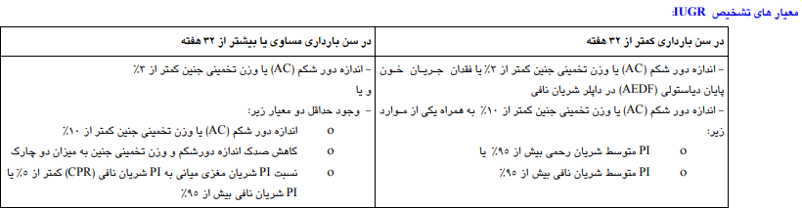

Slide 58
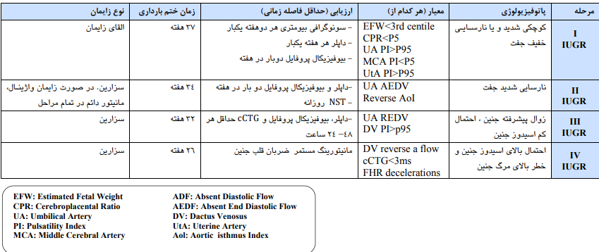

Slide 59


Thanks for your attention

